Slide 1

Soft Computing in Other
Application Areas

Slide 2
Legal Threat Assessment
In this chapter, we develop a complete expert system for legal threats using the same concepts.
Then we deal with the architecture of the expert system and model to carry out threat management.
Next we analyze the rule and the expert system in terms of the relationship between the linguistic variables and output.
Then we will evaluate the expert system as a whole with given test cases.
We conclude the chapter by considering future work that may be carried out in this field.
We first define a few terms used in the text.

Slide 3
Threat, Judiciary, and Justice
We are all used to threatening others or being threatened by others in our daily lives. Threats may take numerous forms and have numerous causes.
People who are threatened may often feel compelled to act in accordance with the desires of the threatening person or situation.
In this chapter, we specifically deal with the legal threats. Every society or government follows laws for the maintenance of law and order.
These laws ensure the smooth functioning of the society without any worry or “threat.”
A person threatening may easily be able to do it without much risk. But stealing some protected information may be very difficult with high risk of being caught in the process.

Slide 4
Threat, Judiciary, and Justice
Another commonly used term in this context is common law. The common law describes the body of legal principles and concepts that were evolved over many centuries by judges in the English courts of law.
The common law decides the fate of any case when it comes to be solved under any judiciary system.
An understanding of the context of the problem or dispute and the associated norms of the common law leads to a solution of the problem that respects the clauses of the parties and leads to the most fit solution.
The justice system makes every attempt to ensure a person is actually guilty before reaching any verdict and punishing him or her for the offense.
Procedures limit power by providing for wide consultation among interested parties.

Slide 5
Role of Time in Threat
In this section we discuss one of the major reasons for the development of threat assessment systems, which is the factor of time, something that plays a huge role in any system.
The verdict hardly compensates for any loss to the threatened or sufferer. Also the large amount of time spent results in heavy losses to both parties.
At the same time, there are almost a quarter million defendants languishing in jails across the country.
There are huge possibilities of internal stability being lost due to the conflict between individuals or social groups.
Further, there is always a risk of external conflicts. These are the conflicts that may arise between Indian and any other country on any issue.
These two sources determine the threat to the country.

Slide 6
Key Outcomes
In the last part of the chapter, after we have made an in-depth analysis of the system, we will see how the developed system is able to achieve these functionalities.
Manage risk of a particular threat: The main objective of the system being discussed is to prioritize the threats and then evaluate the risk associated with them.
Devise a suitable model for threat categorization and input modeling: Numerous kinds of threat may be potentially exist. The actual concept of threat is vast and can be generalized to a very large level.
It is not possible to study and experiment with all the various kinds of threats.
Appreciate the validity of the fuzzy inference engine in threat management: The fuzzy theory is a good fit for this problem because of its flexibility and wide applicability.
Fuzzy applications are much closer to natural applications and hence have a great capability to model the system much as the natural systems model does.

Slide 7
Motivation
The current socio-economic condition of the country urgently calls for such an expert system for automatic threat assessment based on some parameters that affect the threat.
The system that evolves is a great boon in various ways. The system helps in determining the threat in any given scenario.
Security arrangements may be one such kind of control that is extensively used for the security of all public places.
Thus, a fuzzy rule–based inference engine has to be developed to aid in modeling the threats and evaluating the risks associated with them given the threat prioritization.
The higher the threat, the higher the vulnerability from that threat, and hence proper actions and measures have to be taken for such threats.

Slide 8
Literature Review
In this section we present a brief overview of the various kinds of approaches and systems that have been developed for the purpose of vulnerability assessment.
Threat or risk is prevalent in software and creeps in at the design stage of the software.
Based on the decomposition of applications, analysis evaluates the threats and risks to a system and chooses techniques to mitigate the threats.
They investigated common threats in five areas, each focusing on one particular technological building block for web applications.
The main types of attacks discussed are phishing, eavesdropping, man-in-themiddle, and denial of service (DoS).
This means applying these threat modeling techniques to real-life threats so that they can be applied and risk can be prioritized using the threat mitigation process.

Slide 9
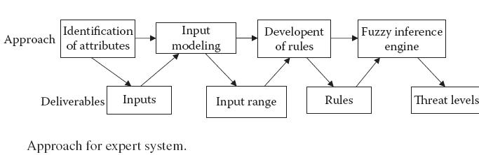
Approach and Objectives
The primary objective of this chapter is to develop an expert system to calculate the prioritized threat and risk. The objectives at the ground level are:
Identification of the attributes that affect the vulnerability to threats
Input modeling of the attributes by giving them appropriate weights and quantification
Development of a rule-based inference engine and expert system

Slide 10
Approach and Objectives
We now state the basic approach used in the development of the threat assessment system. This involves all the various steps we named earlier as making up any expert system.
Each and every input then needs to be engineered. We need a proper metrics using which we can represent it numerically.
Following this, rules have to be devised from the pattern of the cases. These rules are more or less based on common sense, the way we expect the system to work with the given inputs.
Then we integrate all these into the FIS. The FIS takes in the used entered input values and returns the threat in the scenario we engineered it for. The approach is represented in Figure 13.1.

Slide 11
EXPERT SYSTEM
Expert systems are designed to behave just like experts in the field in which they have been trained.
These systems consist of a knowledge base that is developed by acquiring knowledge over a long period of time and stored in a permanent knowledge database.
The output of the expert systems may be of great value when either directly implemented in the system or acting as a guide for the human expert who makes the decisions.
The expert system that we develop here also follows the same principles. We develop a knowledge acquisition system that uses a Java interface to acquire new knowledge and store it in a database or knowledge base.
The fuzzy rules are the rules that map the inputs to the outputs. The outputs are validated against all known knowledge or cases.

Slide 12
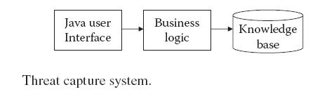
Expert System Architecture
The proposed expert system for the threat management is categorized in three sections.
Threat capture system: The threat capture system takes the input from the user, target, or third party (courts or law enforcing agencies) to develop the knowledge base.
Input modeling: The input modeling is the key part in the expert system. It transforms the input knowledge to quantize it into some range using a logic described in following section.
Inference engine: The third and most important part is the rule-based inference engine. This part does the job of mapping the inputs to the outputs on the basis of the rules that are worked over.

Slide 13
Threat Capture System
This system captures the threat from the source, target, or third party, such as police personnel or courts.
Another major aspect of the system developed is the inputs. The specific domain of threat assessment that we are discussing is the legal threat.
In order to completely understand the system and identify the inputs, we need to study the existing cases that may be obtained from public legal databases, court proceedings, police records, etc.
These all cover a wide variety of threats and possible risks.
Using the information entered here for the knowledge base, we would be able to derive the identified system inputs that we study in the next section.

Slide 14
Threat Capture System
1. Threat type: The threats can be of different types. As per surveys and the possible number of cases in courts, we have identified seven types of threat in a court case:
a) Criminal: This covers criminal charges or threats involving law enforcement. All terrorist threats such as bomb attacks, attacks to a building, robbery, smuggling, or kidnapping should be treated as criminal threats.
b) Denial of access: This is when a right of access has been denie (e.g., denials of access to documents, public places, or court hearings).
c) Disciplinary action: This covers actions by employers, schools, and other organizations that have adverse consequences (e.g., suspensions, demotions).

Slide 15
Threat Capture System
d) Correspondence: This is for informal threats such as email or letters.
e) Lawsuit: This is for threats involving a civil court proceeding.
f) Subpoena: This applies if a subpoena has been used as a legal threat (e.g., to discover
someone’s identity or to request news gathering materials).
g) Other: This is for any other type of threat.
2. Date: The date of legal threat (e.g., date lawsuit was filed; subpoena issued, letter sent, or disciplinary action taken) is given in the DD/MM/YEAR format.
3. Party issuing threat: This is the full name of the person or organization that initiated the legal threat.
4. Party receiving threat: This is the full name of the person or organization that received or responded to the legal threat.

Slide 16
Threat Capture System
5. Source and target locations: This covers the location or state of the source and target.
6. Source and target type: The source and target types can be:
a) Individual: If a person is acting in his or her individual capacity
b) Organization: If the entity is a business or group of individuals acting as an organization
c) Large organization: If the entity is well known or has more than 500 employees (e.g., General Motors, Viacom, RIAA)
d) Government: If a local, state, or central government is involved
e) Intermediary: If the party’s role in the case or controversy involves hosting or transporting content for others (e.g., Facebook, YouTube, Blogger)
f) Media company: If the party is a large or well-known content creator (e.g., Viacom, CNN, New York Times)
g) School: if the party is a public or private educational institution

Slide 17
Threat Capture System
7. Source income: This is the income of the source: i the income of an individual or the revenue of any institution.
8. References: The are possible references the source can produce.
9. Threat content type: The threat content type may be audio, video, plain text, etc.
10. Publication medium: This input covers the means/form of communication at issue in the dispute. This input may be “blog,” “broadcast,” “email,” “forum,” “podcast,” “print,” etc., where all words have their usual meanings. The input is “social networking site” for content on social sites such as MySpace and Facebook; “user comment” for blog comments; and “website” for web content that does not fit into another category.
11. Court Type: This is the court where the case has been filed.
12. Status: This input decides whether the legal threat remains pending. Lawsuits and criminal matters that are on appeal should be marked “pending.”

Slide 18
Threat Capture System
13. Disposition: This input is “dismissed (partial)” if a party or claim has been dismissed but some portion of the case remains; “dismissed (total)” if the entire case has been dismissed; “lawsuit filed” if a letter or other informal threat has resulted in a lawsuit; “settled” if the case or controversy has settled; “verdict” if the case has resulted in liability for a party; and “withdrawn” if the entire case has been withdrawn.
Input Modeling
The input modeling takes the knowledge of the knowledge base to model the input for the fuzzy inference engine.
We cannot just give any weights and then use some mathematical model to find the vulnerability and associated risk of the threat.

Slide 19
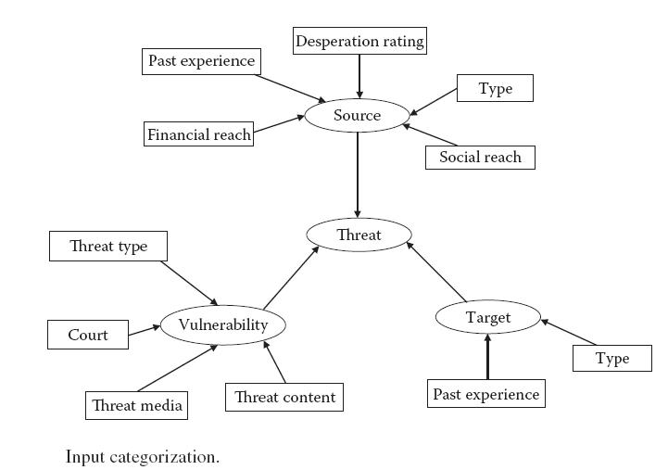
Threat Capture System
The first step in input modeling is to identify the inputs from the knowledge base and their quantization.

Slide 20
Input Quantization
It has been observed that vulnerability to any threat depends upon the three major characteristics. Hence, the input for the fuzzy inference engine can be divided into three parts: source inputs, target inputs, and threat inputs.
Source Input
All the input related to source is taken into consideration. The source plays a very important role in identifying the risk of the threat. The following input is taken:
Source Type
This input is the type of the source. Sources are broadly categorized into seven categories, with category 6 as “Others” if the source type does not fall in any of the other categories.
The range for this input is 0 to 6. The value of source type is summarized in Table 13.1(a).

Slide 21
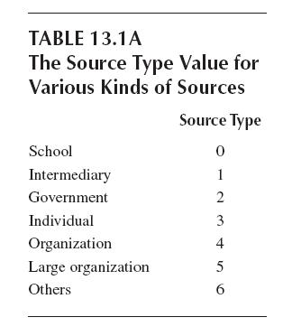

Source Type
Past Experience
Source past experience is the behavior of the source. If we get any cases of source from the knowledge base, we can be able to derive the source_past_experience as the positive cases from the source.

Slide 22

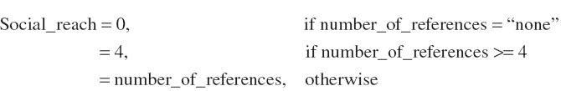
Desperation Rating
This input is measured from the number of threats. The range of this input is between 0 and 4. The desperation rating is taken as the number of threats, up to a maximum of 4. Initially the rating is 0.
Financial Capability
This input depends upon the source type and source income. It is a real input between 0 and 1.
Social Capability
This input measures the source’s social reach and behavior in society. It is very unlikely that if the source has good social capability it can produce an effective threat.

Slide 23
Target Input
Target Type
This type is the sum of seven constituent units. Each unit is assigned a weight.
If that unit is present, its weight is added to the target type inputs. In this manner, target type adds the weights of present constituent units.
Target Past Experience
This type is the number of cases where a verdict has been reached and the verdict is against.
The range of this input is between 0 and 10. Any input larger than 10 is restricted to 10.

Slide 24
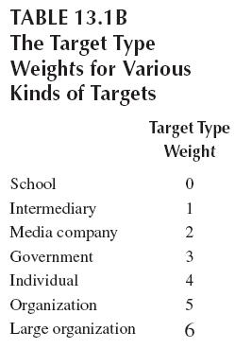
Vulnerability Input
The threat also depends on the way the threat is conveyed or filed, for example. Hence the following input is taken:
Threat Type
This input lies in the range of 0 to 6. The threat type is 1 for denial of access, 2 for correspondence, 3 for disciplinary action, 4 for subpoena, 5 for lawsuit, 6 for criminal, and 0 for others. This is summarized in Table

Slide 25
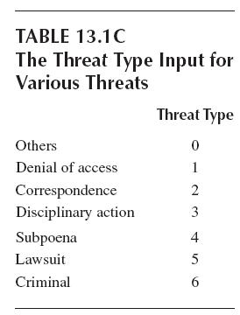
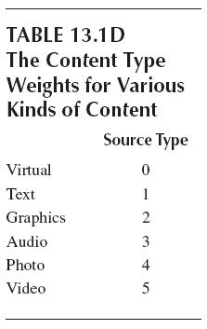
Content Type
This input is the sum of six constituents that collectively form the content. Each has a weight associated with it. If the constituent is present, its weight is added to the content type.
These are virtual with 0 weight, text with a weight of 1, graphics with a weight of 2, audio with a weight of 3, photo with a weight of 4, and video with a weight of 5.
Court Type

Slide 26
Publication Media
Like the content type, this input is also the sum of individual constituents.
The weights are 1 for user comment, 2 for website, 3 for social networking sites, 4 for forum, 5 for blog, 6 for broadcast, 7 for email, 8 for phone, 9 for podcast, 10 f
Fuzzification of Input
This is the process of generating membership values for a fuzzy variable using membership functions.
Once the crisp inputs are obtained, they are fuzzified using the designated fuzzy membership functions.
Linguistic values are assigned for each threat level as Very Low, Low, Rather Low, Medium, Rather High,
High, and Very High.
The MFs for the inputs and outputs are shown in Figure 13.4 for the source system, Figure 13.5 for the target system

Slide 27
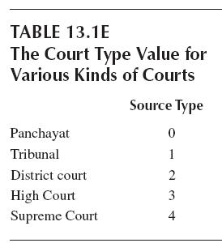
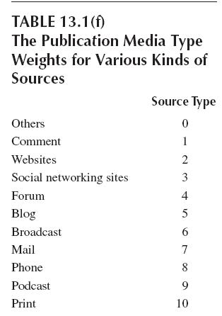
Fuzzification of Input

Slide 28
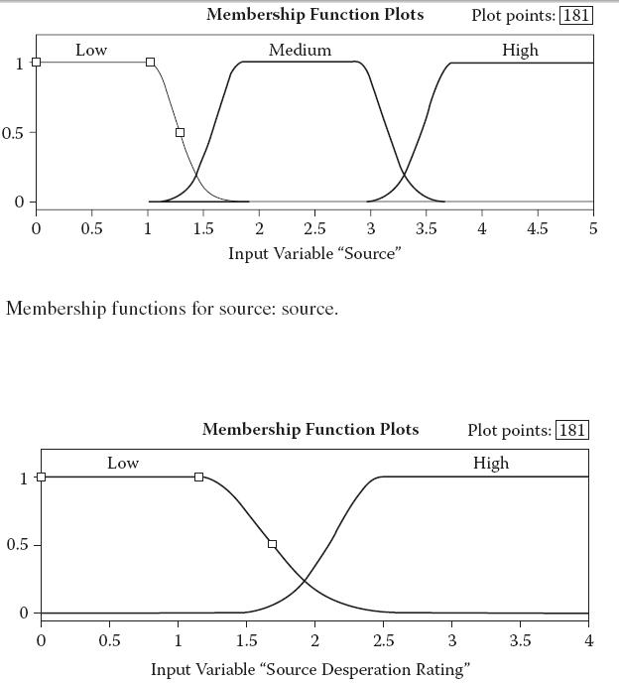

Fuzzification of Input

Slide 29
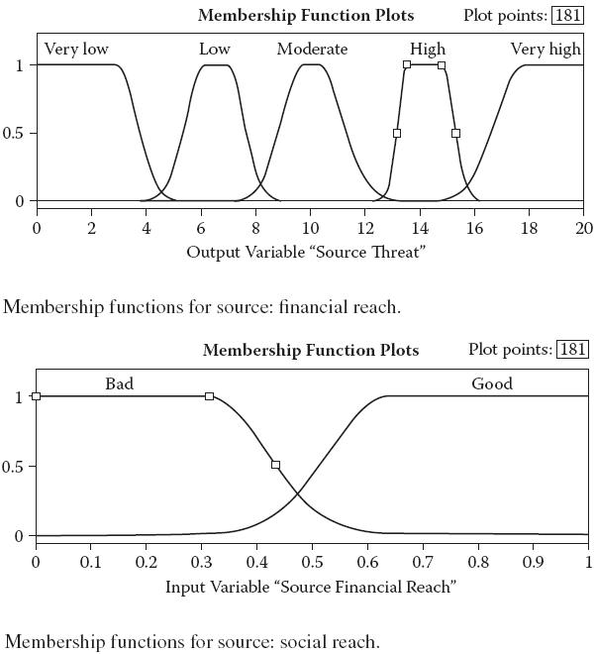
Fuzzification of Input

Slide 30
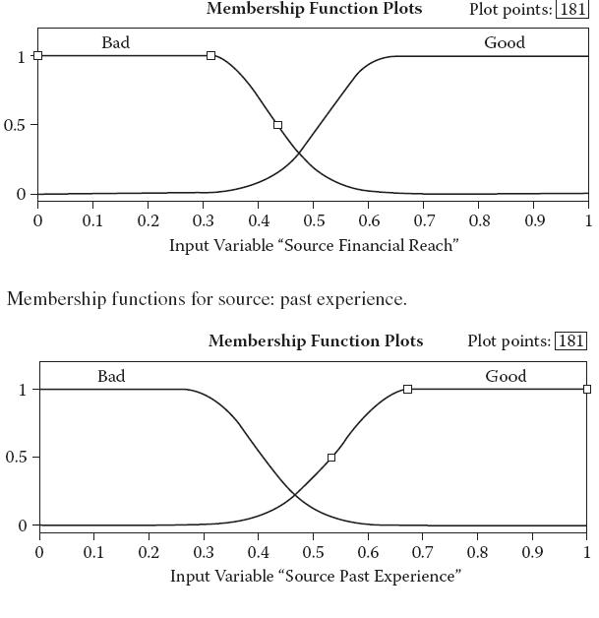
Fuzzification of Input

Slide 31
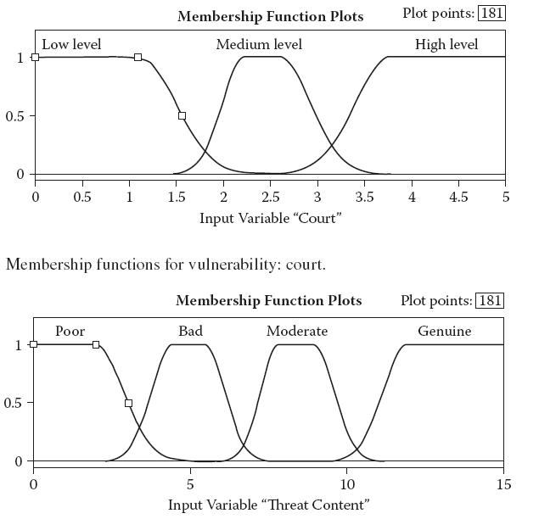
Fuzzification of Input

Slide 32
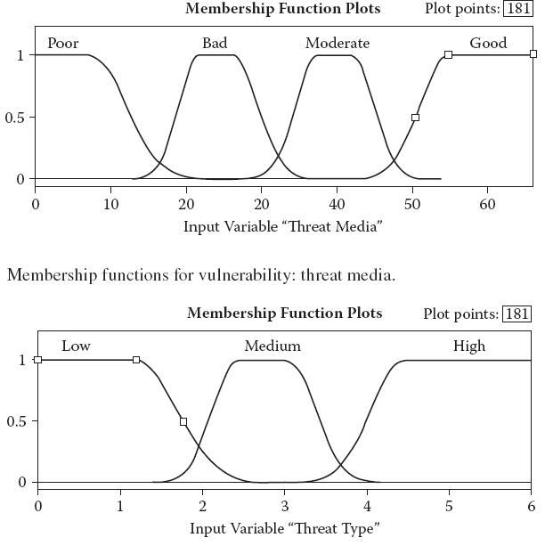
Fuzzification of Input

Slide 33
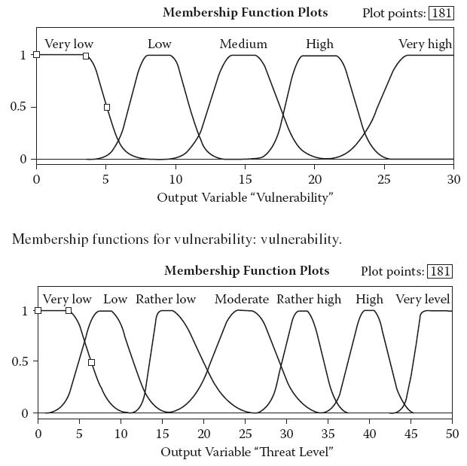

Fuzzification of Input

Slide 34
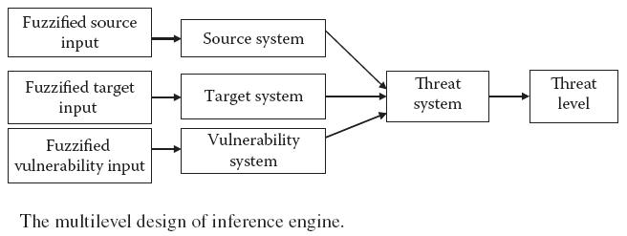
Fuzzification of Input

Slide 35
FUZZY INFERENCE SYSTEM
The task of FIS is to use the inputs and map them to the corresponding outputs using the fuzzy rules.
The fuzzy rules depict the general rules for the mapping using simple rules that are built.
In order to develop the FIS for the threat management, four inference systems have been developed.
The system is shown in Figure 13.8.
This will be elaborated later in the chapter. The inference engine used is the Mamdani type for all the rule-based engines using the centroid algorithm for defuzzification.

Slide 36
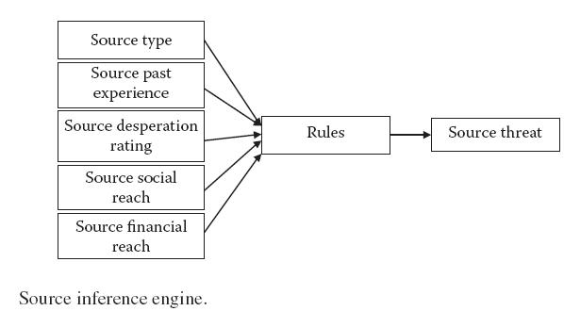
Source System
The source system plays very important role in determining the threat level.
We had already identified the fuzzified inputs for the source in previous chapter.
The rules are designed using the Matlab rule editor. Rules are developed entirely in unison with the survey and observed pattern of the threat and disposition from the Citizen Media Legal Database.

Slide 37
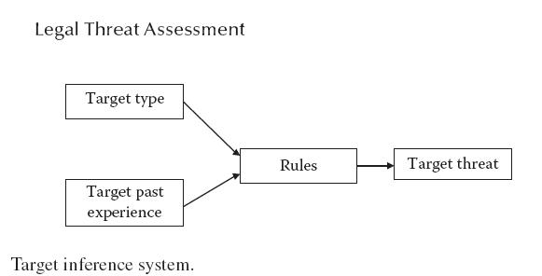
Source System
and if the source_desperation_rating is high, then the source_threat will be greater than or equal to moderate, i.e.:
If (source_desperation_rating is low) then (Source_threat e {Very_low, Low, Rather_low, Moderate })
If (source_desperation_rating is High) then (Source_threat e { Moderate, Rather_high, High, Very_high})

Slide 38
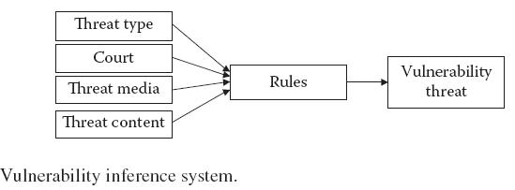
Target System
Similar to the source system, the target system is also a fuzzy inference engine with a Mamdanitype engine.
The target_past_experience is the variable that determines the past experience of the target and the vulnerability of target itself.
In algorithmic form,
Initially, target_past_experience = 0; (signifies low)
If (disposition(target) = favorable)
target_past_experience ← target_past_experience + 1
Else
If(target_past_experience > 0)
target_past_experience ← target_past_experience – 1;

Slide 39
Vulnerability System
Sometimes, the source and target demographics alone are not able to identify the true nature of the threat.
The important variables for the vulnerability of the threat identified are threat_type and threat_ media both.
So
If (threat_type e [Low]) and (threat_media e [Poor, Bad]) the (Vulnerability e [Very_low, Low])
If(threat_type e [Medium]) and (threat_media e [Poor, Bad]) then (Vulnerability e [Low, Moderate])
If(threat_type e [High]) and (threat_media e [Poor, Bad]) then (Vulnerability e [Moderate, High])
If(threat_type e [High]) and (threat_media e [Good]) then (Vulnerability e [Very_High]) And so on.
The output range of the vulnerability is [0 30].

Slide 40
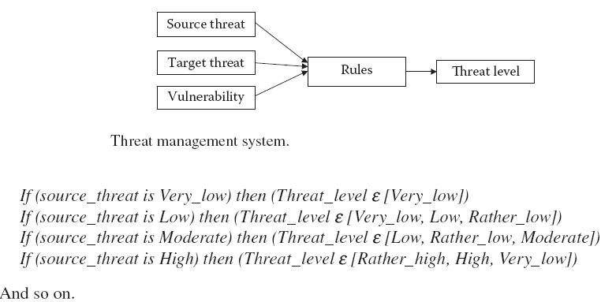
Threat Management System
The threat management system is the final inference engine of the expert system.
Since all these attributes are different from each other to some extent, a different inference engine is designed for each of these to calculate the threat from the source perspective, the target perspective, and the threat perspective.
The source_threat and target_threat with the vulnerability determines the threat_level.

Slide 41
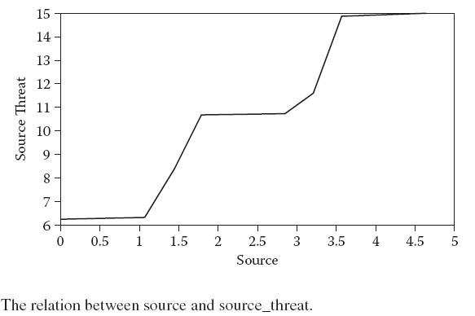
ANALYSIS OF RULES AND INFERENCE ENGINE
Source System
The source system is the inference engine for the source_threat.
The linguistic variables and fuzzification have already been discussed in the preceding section.
The past experience in Figure 13.13d shows a negative trend with vulnerability with a decrease in vulnerability with the increase in past experience of the source.

Slide 42
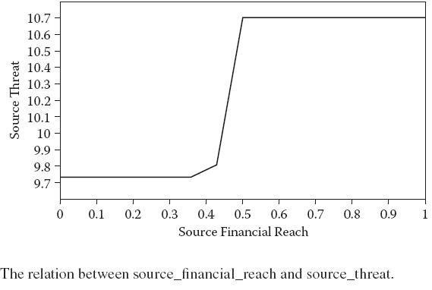
Source System

Slide 43
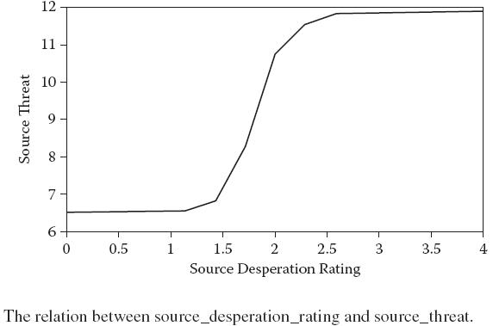
Source System

Slide 44
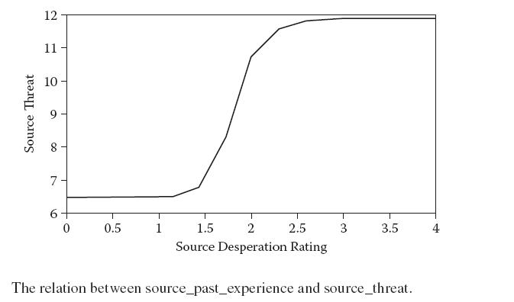
Source System

Slide 45
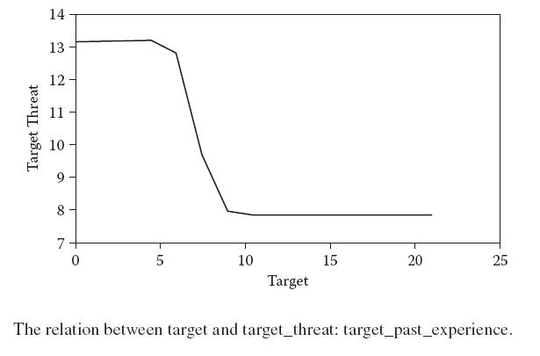
Source System

Slide 46
Target System
Target System is the inference engine for the target_threat. The linguistic variables for the target system are target and target_past_experience.
The output range of the target_threat is [0 20]. The relation between different variables with the target_threat is shown in Figure 13.14.
Figure 13.14a makes it clear that there is a decrease of target_threat with the increase in the value of target.
Figure 13.14b shows almost a similar trend with past experience and target_threat.

Slide 47
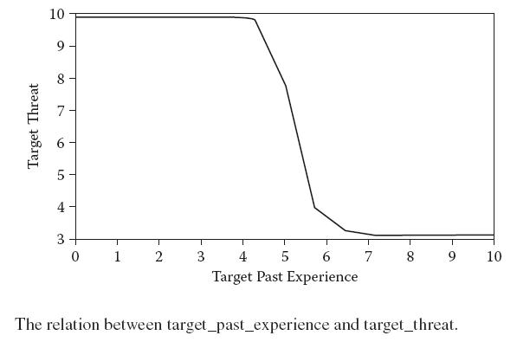
Vulnerability System
Vulnerability System is the inference engine for the finding the threat vulnerability and is the last key ingredient for the threat management system.
Here it may be easily observed that the vulnerability remains almost zero initially with very little increase.

Slide 48
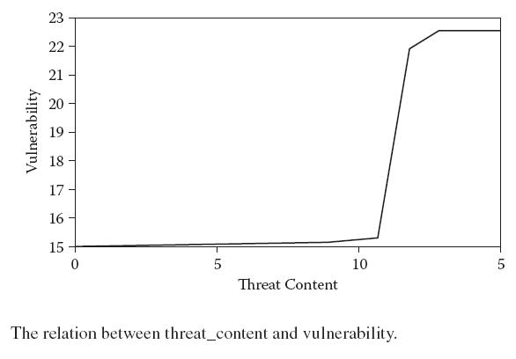
Vulnerability System

Slide 49
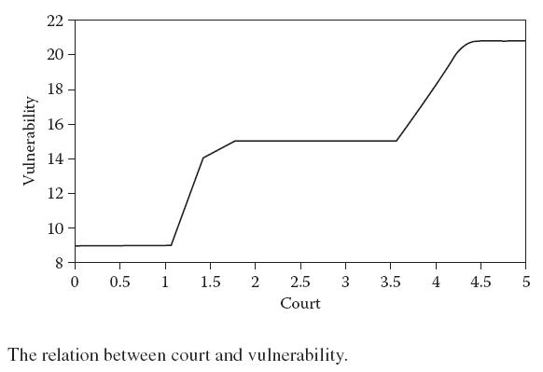
Vulnerability System

Slide 50
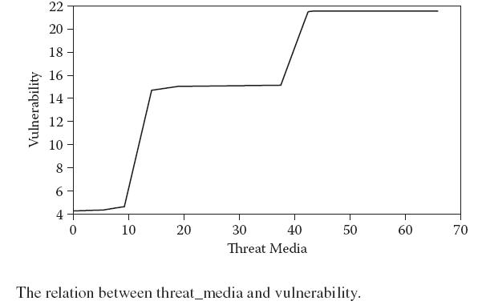
Vulnerability System

Slide 51
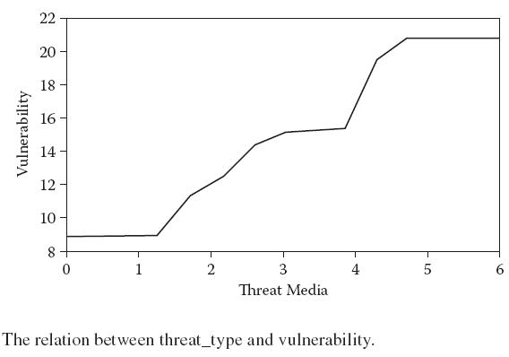
Vulnerability System

Slide 52
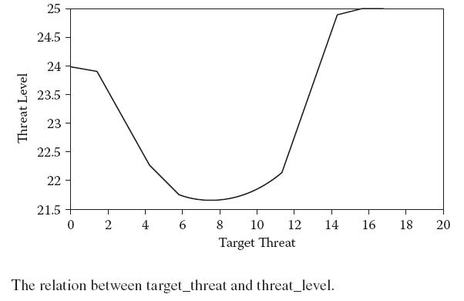
Threat Management System
The threat management system is the final inference engine used to determine the threat_level from the variables source_threat, target_threat, and vulnerability of the threat.
The other two variables, source_threat and vulnerability, have a similar curve, which shows a uniform increase in threat level with their increase. These are given in Figures 13.16b and 13.16c.

Slide 53
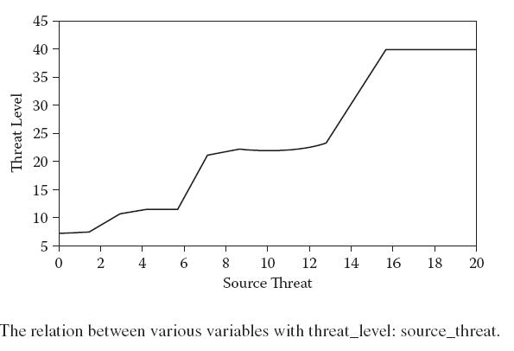
Threat Management System

Slide 54
EVAL UATION OF THE EXPERT SYSTEM
The expert system was evaluated with a focus upon the risk and level of threat.
To determine the appropriateness of the approach taken in the chapter, the threat level of the court cases is assessed.
To do this, we compare the threats register in court and their disposition and status from Citizen Media Legal Database with the threat levels of the expert system.
The final and most important area is the evaluation of how threat inference engine validates the correct rules.

Slide 55
The Aim of Testing
The overarching aim of the testing was, of course, to determine if the approach taken in creating the expert system to determine the threat level was appropriate.
That is, should the domain of rulebased reasoning be used exclusively by courts and law enforcement agency to prioritize threats?
To assess the appropriateness of the approach taken, different areas of testing were determined: validity, correctness, input contribution, and threat prioritization.
The Performance Benchmark
In this section we shall present theorems that show that the knowledge representation and inference engine of the threat management system is valid, correct, and optimal.

Slide 56
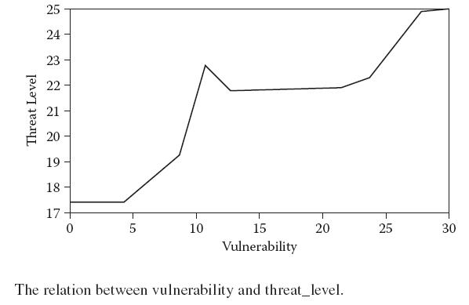
The Performance Benchmark

Slide 57
Validity
The legal threat depends on the socioeconomic factors of the target and the source. The expert system uses the knowledge base to model the linguistic variables and then apply the rule-based inference engine.
Mostly, systems fail or throw exceptions in extreme boundary conditions.
So in a nutshell, the validity of the system is the proper function of the system at the extreme condition.
Correctness
Input to a system is a sequence of values to be assigned to attributes, and output consists of a sequence of actions that are executed.
So, correctness is defined as the ability of the system to give the same result as is given by the courts and other experts under the same scenario.

Slide 58
Effectiveness
The input contribution for any inference engine is depicted by the chart that shows how the inference engine is affected by the inputs.
The basic definition of effectiveness is the extent to which planned activities are realized and planned results achieved.
Competence
The basic aim of expert system is to prioritize the number of threats/cases received over a period.
The prioritization of threats should be done on the basis of risk and vulnerability associated with them.
Test Pack
The test cases are taken from the Citizen Media Law Project. The database contains lawsuits, cease and desist letters, subpoenas, and other legal threats directed at those who engage in online speech.

Slide 59
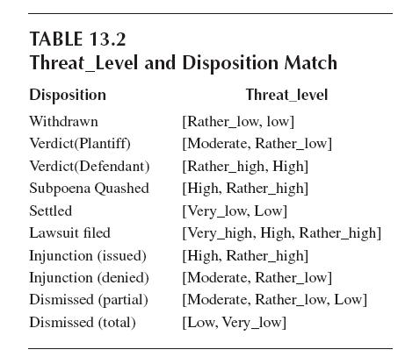
Test Case: State v. King

Slide 60
Test Pack
Harold King runs the forum site “McAlester Watercooler,” which he describes as a forum for citizens of McAlester, Oklahoma, to “voice their views about the on-going City events.”
Threat type: Criminal
Date: 08/16/2005
Party Issuing Threat: State of Oklahoma
Party Receiving Threat: Harold King
Type of Threatening Party: Government
Type of Threatened Party: Individual
Location of Source: Oklahoma
Location of Target: Oklahoma
Status: Concluded Disposition: Withdrawn
Court Type: District
Publication Medium: Forum, website
Content Type(s): Text

Slide 61
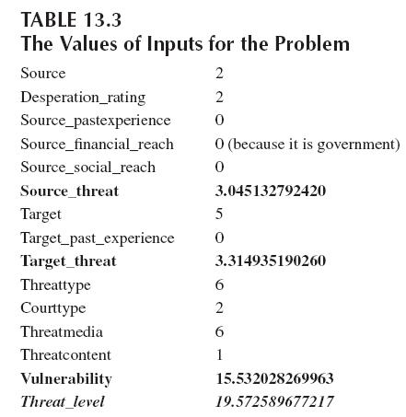
Test Pack
The threat_level is 19.572589677217, which corresponds to rather_low. Hence, the disposition is withdrawn from the source (State of Oklahoma), as the chances of winning the case is rather_low.

Slide 62
The Performance of the Expert System
Now, after the development of test packs with a lot of test cases from the Citizen Media Law Database, extensive testing is been done to check the performance of the expert system.
The similar kind of evaluation is done in various other cases from the Citizen Media Law Database.
The test was first performed on a test pack of 30 cases. Then the test was performed on the complete database.
Results
On the basis of the previous experiment and result, we can check our expert system on the performance benchmark discussed in the preceding section.
Correctness
The correctness is the measure of the system’s capability to produce a correct result. In the 30 test cases, the system correctly identified all of them.
Therefore, a 98.20 percent success rate would be considered good.

Slide 63
The Performance of the Expert System
Validity
The system will be valid if it is able to produce results in any dire situation.
Even if there are no inputs, the system should be able to give results. The system’s extreme conditions would be the low and the high.
This implies that rules were devised properly, and the input modeling module is correctly derived from the knowledge base.
Effectiveness
The dependency of the rules to the output is checked with the help of 30 test cases of the test pack.
The contribution of input variables to the output variables was studied here.
Competence
Suppose the court or law enforcing agency received n cases/threats. The question is prioritizing the threats according to their potential for damage and risk of occurrence.

Slide 64
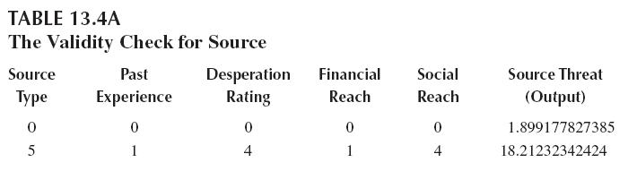
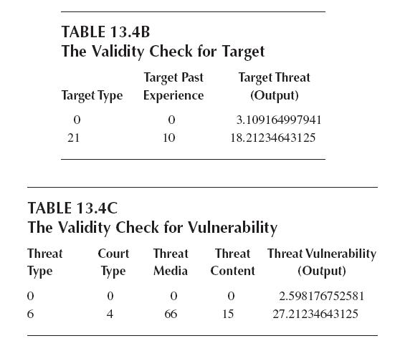
Competence
For example, consider the test pack of 30 test cases. The threats with priority for first three cases come out as shown in Table 13.5.

Slide 65
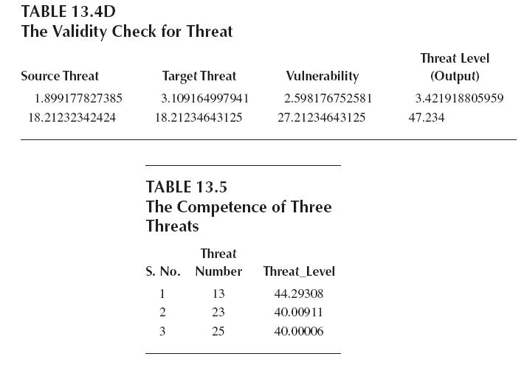
Competence

Slide 66
CONCLUSION
Here we again make an overview of the system, considering the objectives and trying to analyze how far we have been able to achieve these objectives.
We also look at the system applicability that we had specified in the introduction of the chapter.
Implication of the Results
The main objective of the system was to develop a system that would model the threats and prioritize them by risk and vulnerability.
Furthermore, the validity of the system implies that system will be able to take any inputs and perform and give desired results by prioritizing those results.
The system will stand up even in extreme boundary cases. This shows that fuzzy rules are properly designed and so is the input modeling from the knowledge base.

Slide 67
Key Outcomes
It is expected for the developed systems to meet these outcomes in order to be able to be used in real life.
Managing risk of a particular threat: The main objective of the chapter is to prioritize the threats and then evaluate the risk associated with them.
The threats having higher value is more risky and hence have been given a higher priority than other threats.
To devise a suitable model for threat categorization and input modeling: Threat categorization and input modeling are done on the basis of inputs, and different levels of the inference engine are built so that their inputs could be modeled independent of each other.
A mathematical logic is developed to isolate the linguistic variables from the knowledge base.
Validity of fuzzy inference engine in threat management: The threat and input attributes that directly or indirectly influence the threat cannot be a crisp input.

Slide 68
Future Work
There is still a lot more that can be added to the current system and developed even more to be better applicable in real life.
We can further explore the input identified for the knowledge base. A number of other parameter may be helpful to properly formulate the system.
A few parameters, like source financial reach, source social reach, • and past experience, were calculated according to a naïve approach. A comprehensive study is needed in this direction to properly model those parameters.
The membership functions of the variables can also improved to give more options while developing the rules.
Risk mitigation and other risk management concepts can also be applied to the threat level to manage the risk properly.

